Slide 1
Atmospheric entry
From Wikipedia, the free encyclopedia
https://en.wikipedia.org/wiki/Atmospheric%20entry
Licensed under CC BY-SA 3.0:
https://en.wikipedia.org/wiki/Wikipedia:Text_of_Creative_Commons_Attribution-ShareAlike_3.0_Unported_License

Slide 2
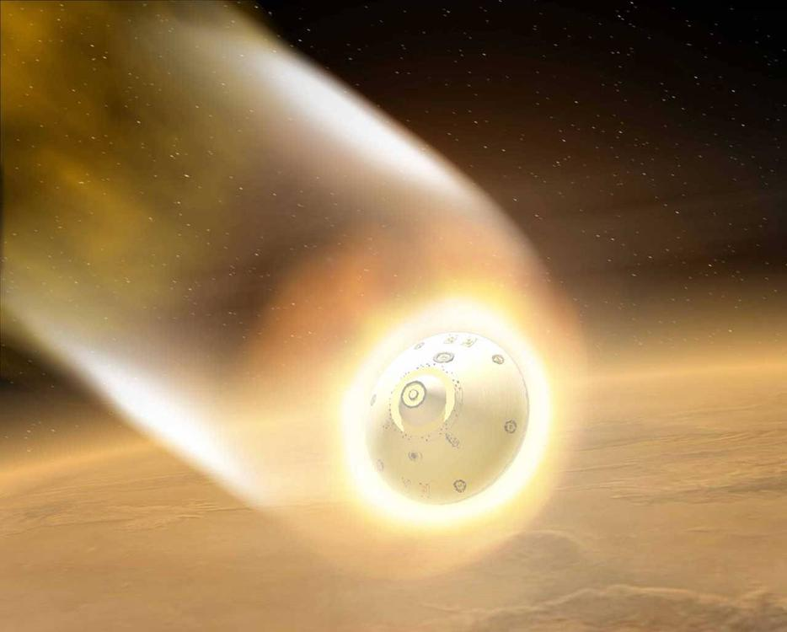
Mars Exploration Rover (MER) aeroshell, artistic rendition

Slide 3
Atmospheric entry
There are two main types of atmospheric entry: uncontrolled entry, such as the entry of astronomical objects, space debris, or bolides; and controlled entry (or reentry) of a spacecraft capable of being navigated or following a predetermined course.
While the high temperature generated at the surface of the heat shield is due to adiabatic compression, the vehicle's kinetic energy is ultimately lost to gas friction (viscosity) after the vehicle has passed by.

Slide 4
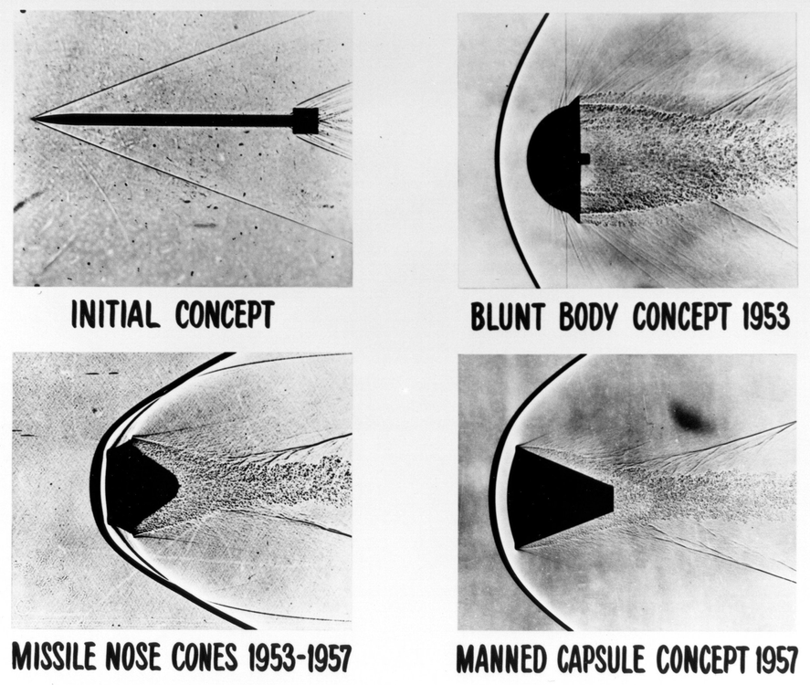
Early reentry-vehicle concepts visualized in shadowgraphs of high speed wind tunnel tests

Slide 5
History
From simple engineering principles, Allen and Eggers showed that the heat load experienced by an entry vehicle was inversely proportional to the drag coefficient; i.e., the greater the drag, the less the heat load.
Since most of the hot gases are no longer in direct contact with the vehicle, the heat energy would stay in the shocked gas and simply move around the vehicle to later dissipate into the atmosphere.

Slide 6
Terminology, definitions, and jargon
When atmospheric entry is part of a spacecraft landing or recovery, particularly on a planetary body other than Earth, entry is part of a phase referred to as entry, descent, and landing, or EDL.
When the atmospheric entry returns to the same body that the vehicle had launched from, the event is referred to as reentry (almost always referring to Earth entry).

Slide 7
Entry vehicle shapes
There are several basic shapes used in designing entry vehicles:

Slide 8
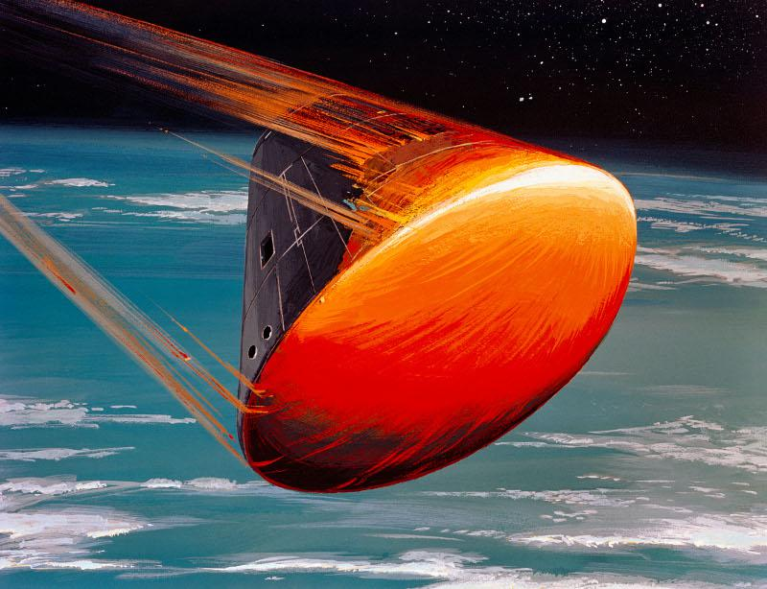
Apollo command module flying with the blunt end of the heat shield at a non-zero angle of attack in order to establish a lifting entry and control the landing site (artistic rendition)

Slide 9
Sphere or spherical section
Likewise, the spherical section's heat flux can be accurately modeled with the Fay-Riddell equation.
Pure spherical entry vehicles were used in the early Soviet Vostok and Voskhod capsules and in Soviet Mars and Venera descent vehicles.
The Apollo command module used a spherical section forebody heat shield with a converging conical afterbody.

Slide 10
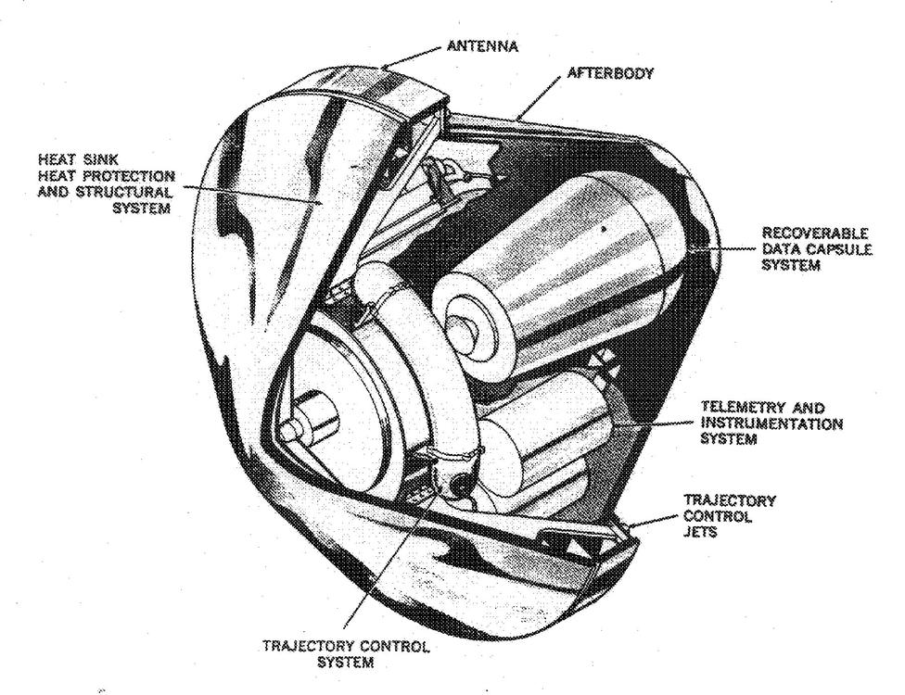
Prototype of the Mk-2 Reentry Vehicle (RV), based on blunt body theory.

Slide 11
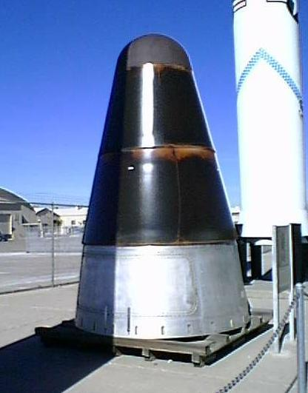
Mk-6 RV, Cold War weapon and ancestor to most of the U.S. missile entry vehicles.

Slide 12
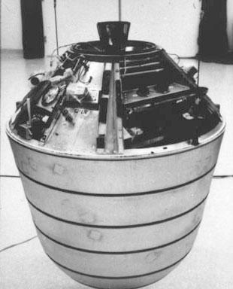
"Discoverer" type reconnaissance satellite film Recovery Vehicle (RV)

Slide 13
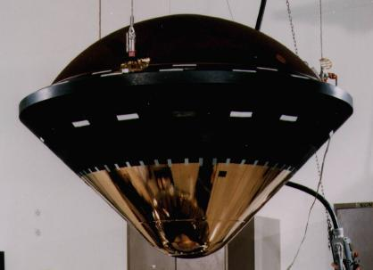
Galileo Probe during final assembly

Slide 14
Sphere-cone
The Mk-2's design was derived from blunt-body theory and used a radiatively cooled thermal protection system (TPS) based upon a metallic heat shield (the different TPS types are later described in this article).
This new TPS was so effective as a reentry heat shield that significantly reduced bluntness was possible.

Slide 15
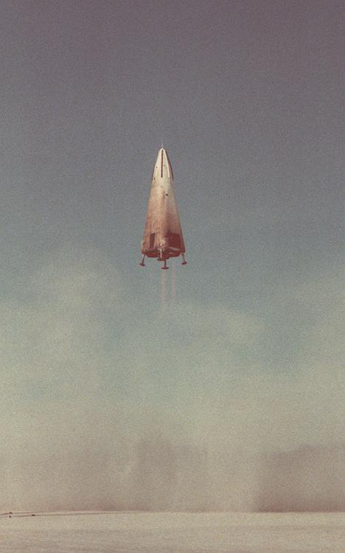
The DC-X, shown during its first flight, was a prototype single stage to orbit vehicle, and used a biconic shape similar to AMaRV.

Slide 16
Biconic
Arguably, the most significant biconic ever flown was the Advanced Maneuverable Reentry Vehicle (AMaRV).

Slide 17
Non-axisymmetric shapes
Non-axisymmetric shapes have been used for manned entry vehicles.
The lifting body is another entry vehicle geometry and was used with the X-23 PRIME (Precision Recovery Including Maneuvering Entry) vehicle.
The proposed MOOSE system would have used a one-man inflatable ballistic capsule as an emergency astronaut entry vehicle.

Slide 18
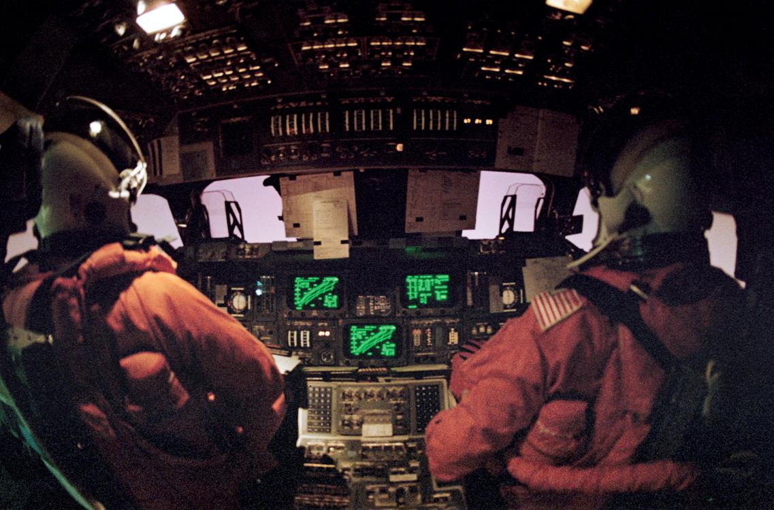
Cabin view of the space shuttle during STS-42 re-entry.

Slide 19
Reentry heating
Objects entering an atmosphere from space at high velocities relative to the atmosphere will cause very high levels of heating.
Reentry heating comes principally from two sources:
Radiative heating—which is highly wavelength dependent—thus predominates very early in atmospheric entry while convection predominates in the later phases.

Slide 20
Shock layer gas physics
At typical reentry temperatures, the air in the shock layer is both ionized and dissociated.
There are four basic physical models of a gas that are important to aeronautical engineers who design heat shields:

Slide 21
Perfect gas model
The perfect gas theory is elegant and extremely useful for designing aircraft but assumes that the gas is chemically inert.
The perfect gas theory begins to break down at 550 K and is not usable at temperatures greater than 2,000 K. For temperatures greater than 2,000 K, a heat shield designer must use a real gas model.

Slide 22
Real (equilibrium) gas model
An entry vehicle's pitching moment can be significantly influenced by real-gas effects.
For example, in the case of the Galileo Probe's entry into Jupiter's atmosphere, the shock layer was mostly in equilibrium during peak heat flux due to the very high pressures experienced (this is counterintuitive given the free stream velocity was 39 km/s during peak heat flux).

Slide 23
Real (non-equilibrium) gas model
An important aspect of modelling non-equilibrium real gas effects is radiative heat flux.
If a vehicle is entering an atmosphere at very high speed (hyperbolic trajectory, lunar return) and has a large nose radius then radiative heat flux can dominate TPS heating.
However, radiative heat flux in carbon dioxide (Mars entry) is still barely understood and will require major research.

Slide 24
Frozen gas model
Frozen gas can be a significant issue in the wake behind an entry vehicle.
During reentry, free stream air is compressed to high temperature and pressure by the entry vehicle's shock wave.
The frozen air can then be entrained into a trailing vortex behind the entry vehicle.
Correctly modelling the flow in the wake of an entry vehicle is very difficult.

Slide 25
Thermal protection systems
A thermal protection system or TPS is the barrier that protects a spacecraft during the searing heat of atmospheric reentry.
A secondary goal may be to protect the spacecraft from the heat and cold of space while in orbit.

Slide 26
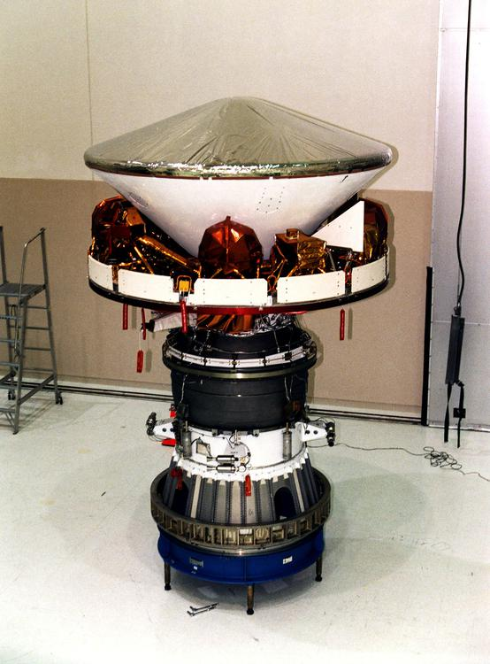
Mars Pathfinder during final assembly showing the aeroshell, cruise ring and solid rocket motor

Slide 27
Ablative
The ablative heat shield functions by lifting the hot shock layer gas away from the heat shield's outer wall (creating a cooler boundary layer).
If the heat flux experienced by an entry vehicle is insufficient to cause pyrolysis then the TPS material's conductivity could allow heat flux conduction into the TPS bondline material thus leading to TPS failure.

Slide 28
Super light-weight ablator
SLA-561V is a proprietary ablative made by Lockheed Martin that has been used as the primary TPS material on all of the 70° sphere-cone entry vehicles sent by NASA to Mars other than the Mars Science Laboratory (MSL).
The MSL aeroshell TPS is currently designed to withstand a peak heat flux of 234 W/cm².

Slide 29
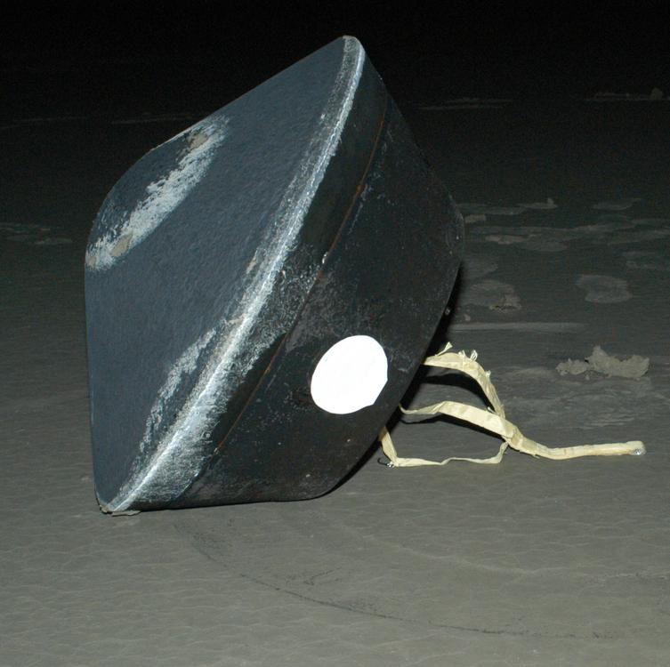
NASA's Stardust sample return capsule successfully landed at the USAF Utah Range.

Slide 30
Phenolic-impregnated carbon ablator
PICA was patented by NASA Ames Research Center in the 1990s and was the primary TPS material for the Stardust aeroshell.
A PICA heat shield was also used for the Mars Science Laboratory entry into the Martian atmosphere.

Slide 31
PICA-X
The first reentry test of a PICA-X heat shield was on the Dragon C1 mission on 8 December 2010.
The PICA-X heat shield was designed, developed and fully qualified by a small team of only a dozen engineers and technicians in less than four years.
PICA-X is ten times less expensive to manufacture than the NASA PICA heat shield material.

Slide 32
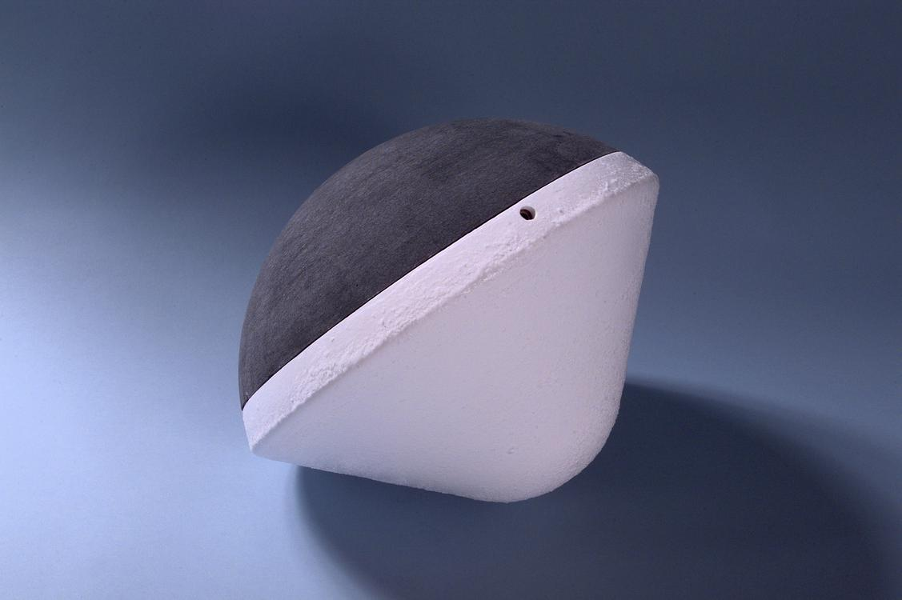
Deep Space 2 impactor aeroshell, a classic 45° sphere-cone with spherical section afterbody enabling aerodynamic stability from atmospheric entry to surface impact

Slide 33
SIRCA
SIRCA was also the primary TPS material for the unsuccessful Deep Space 2 (DS/2) Mars impactor probes with their 0.35 m base diameter aeroshells.
It is the only TPS material that can be machined to custom shapes and then applied directly to the spacecraft.
There is no post-processing, heat treating, or additional coatings required (unlike Space Shuttle tiles).

Slide 34
AVCOAT
AVCOAT is a NASA-specified ablative heat shield, a glass-filled epoxy–novolac system.
NASA originally used it for the Apollo capsule in the 1960s, and then utilized the material for its next-generation beyond low Earth-orbit Orion spacecraft, slated to fly in the late 2010s.

Slide 35
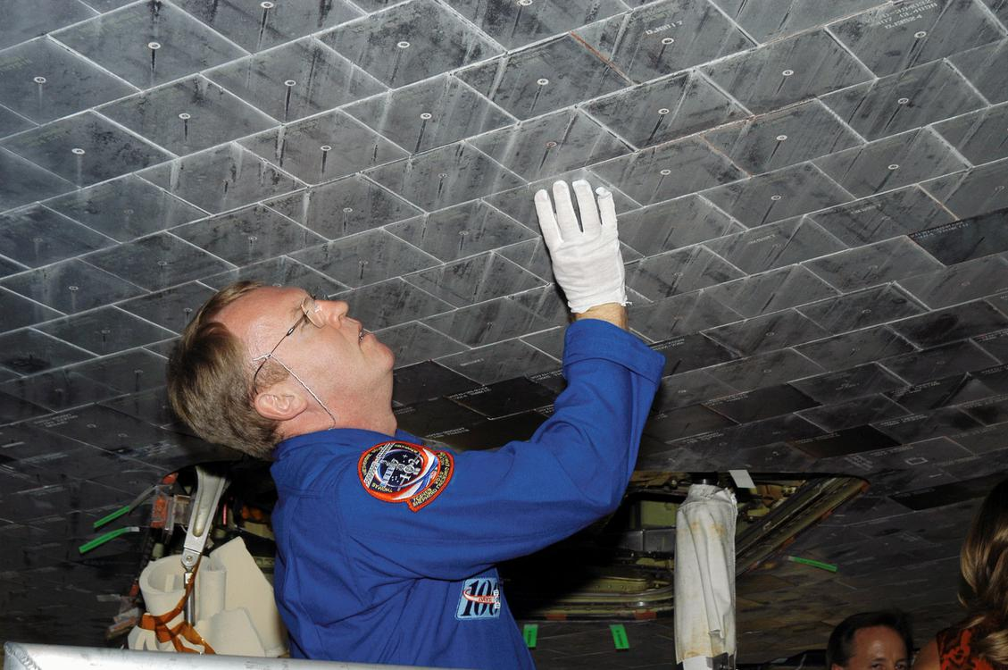
Astronaut Andrew S. W. Thomas takes a close look at TPS tiles underneath Space Shuttle Atlantis.

Slide 36
Thermal soak
From that time to the end of the heat pulse, heat from the shock layer convects into the heat shield's outer wall and would eventually conduct to the payload.
[citation needed] This outcome is prevented by ejecting the heat shield (with its heat soak) prior to the heat conducting to the inner wall.
Typical Space Shuttle TPS tiles (LI-900) have remarkable thermal protection properties.

Slide 37
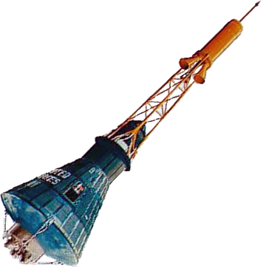
The Mercury capsule design (shown here with its escape tower) originally used a radiatively cooled TPS, but was later converted to an ablative TPS.

Slide 38
Passively cooled
In some early ballistic missile RVs (e.g., the Mk-2 and the suborbital Mercury spacecraft), radiatively cooled TPS were used to initially absorb heat flux during the heat pulse, and, then, after the heat pulse, radiate and convect the stored heat back into the atmosphere.
A radiatively cooled TPS for an entry vehicle is often called a hot-metal TPS.

Slide 39
Actively cooled
Such a TPS concept was proposed[when?]
SpaceX is currently developing an actively cooled heat shield for its Starship spacecraft where a part of the thermal protection system will be a transpirationally cooled outer skin design for the reentering spaceship.
In the early 1960s various TPS systems were proposed to use water or other cooling liquid sprayed into the shock layer, or passed through channels in the heat shield.

Slide 40
Feathered reentry
The aircraft thus slows down more in higher atmospheric layers which is the key to efficient reentry.
However, the velocity attained by SpaceShipOne prior to reentry is much lower than that of an orbital spacecraft, and engineers, including Rutan, recognize that a feathered reentry technique is not suitable for return from orbit.

Slide 41
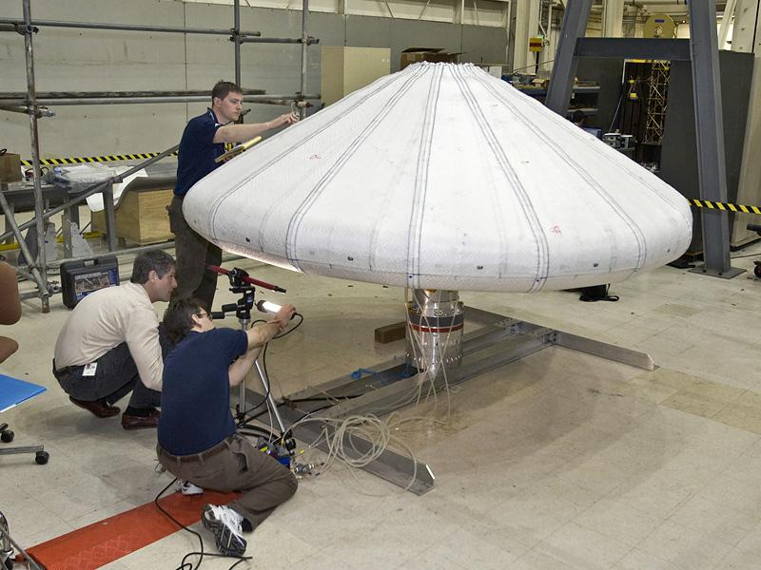
NASA engineers check IRVE.

Slide 42
Inflatable heat shield reentry
Deceleration for atmospheric reentry, especially for higher-speed Mars-return missions, benefits from maximizing "the drag area of the entry system.
The Inflatable Reentry and Descent Technology (IRDT) demonstrator was launched on Soyuz-Fregat on 8 February 2000.
Although the second stage of the shield failed to inflate, the demonstrator survived the orbital reentry and was recovered.

Slide 43
NASA IRVE
NASA launched an inflatable heat shield experimental spacecraft on 17 August 2009 with the successful first test flight of the Inflatable Re-entry Vehicle Experiment (IRVE).
"Nitrogen inflated the 10-foot (3.0 m) diameter heat shield, made of several layers of silicone-coated [Kevlar] fabric, to a mushroom shape in space several minutes after liftoff."

Slide 44
NASA HIAD
The forward (convex) face of the cone is covered with a flexible thermal protection system robust enough to withstand the stresses of atmospheric entry (or reentry).
In 2012, a HIAD was tested as Inflatable Reentry Vehicle Experiment 3 (IRVE-3) using a suborbital sounding rocket and worked.

Slide 45
Entry vehicle design considerations
Peak heat flux
Heat load
Peak heat flux and dynamic pressure selects the TPS material.
Heat load selects the thickness of the TPS material stack.
A TPS material that is ideal for high heat flux may be too conductive (too dense) for a long duration heat load.
The rationale for a 45° half-angle is to have either aerodynamic stability from entry-to-impact (the heat shield is not jettisoned) or a short-and-sharp heat pulse followed by prompt heat shield jettison.

Slide 46
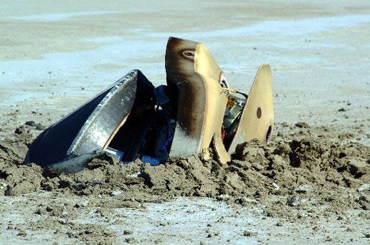
Genesis entry vehicle after crash

Slide 47
Notable atmospheric entry accidents
Soyuz 11 – After tri-module separation, a valve was weakened by the blast and failed on reentry.
Nevertheless, reentry was successful, and the orbiter proceeded to a normal landing.
Consequently, the Genesis entry vehicle crashed into the desert floor.

Slide 48
Uncontrolled and unprotected reentries
NASA had originally hoped to use a Space Shuttle mission to either extend its life or enable a controlled reentry, but delays in the Shuttle program, plus unexpectedly high solar activity, made this impossible.
The China Manned Space Engineering Office had intended to control the reentry, but lost telemetry and control in March 2017.

Slide 49
Deorbit disposal
In 2001, the Russian Mir space station was deliberately de-orbited, and broke apart in the fashion expected by the command center during atmospheric reentry.
Closeup of Gemini 2 heat shield
Cross section of Gemini 2 heat shield

Slide 50
Successful atmospheric reentries from orbital velocities
Manned orbital reentry, by country/governmental entity
United States – Mercury, Gemini, Apollo, Space Shuttle
Manned orbital reentry, by commercial entity
Unmanned orbital reentry, by country/governmental entity
European Space Agency
India / Indian Space Research Organisation
Unmanned orbital reentry, by commercial entity

Slide 51
Selected atmospheric reentries
This list includes some notable atmospheric entries in which the spacecraft was not intended to be recovered, but was destroyed in the atmosphere.

Slide 52
Further reading
Coming Home: Reentry and Recovery from Space.
NASA.
Atmospheric Entry – An Introduction to Its Science and Engineering.
Dynamics of Atmospheric Flight.
Introduction to Physical Gas Dynamics.
NASA.
NASA SP-3096.
Hypersonic and High Temperature Gas Dynamics.

Slide 53
External links
Apollo Atmospheric Entry Phase, 1968, NASA Mission Planning and Analysis Division, Project Apollo.
Buran's heat shield

